Slide 2
learn visual data analysis techniques.
understand benefits of good data visualization
learn different types of analysis for data visualization.

Slide 3
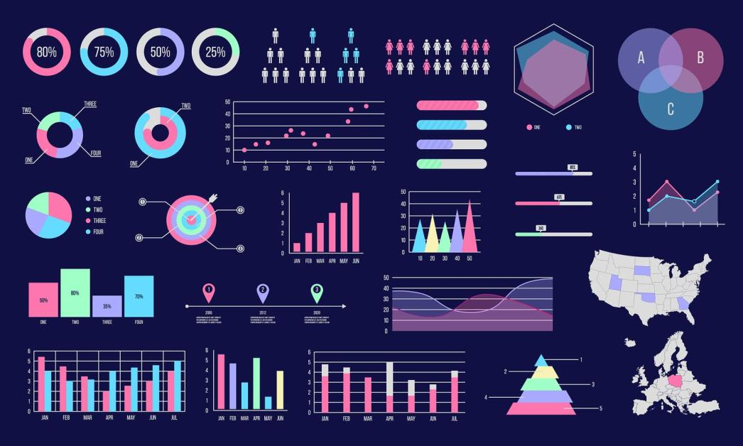
Introduction

Slide 4
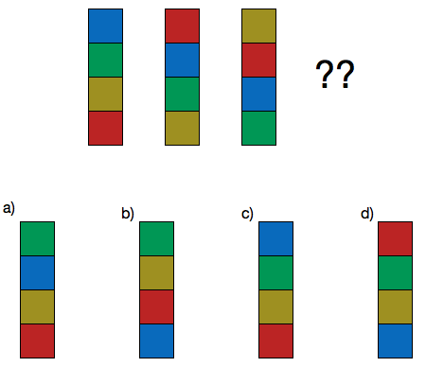
Introduction
Identify Patterns

Slide 5

Introduction
Identify Patterns
Corrupt Data

Slide 6
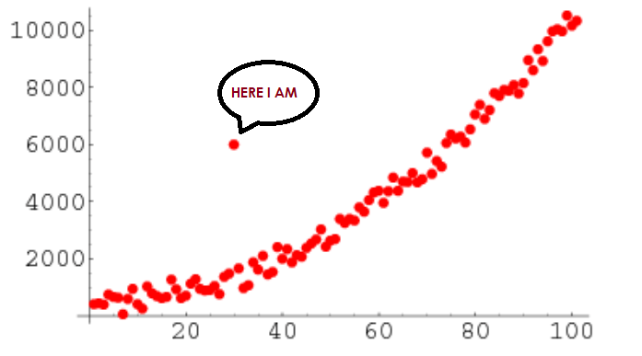
Introduction
Outlier

Slide 7
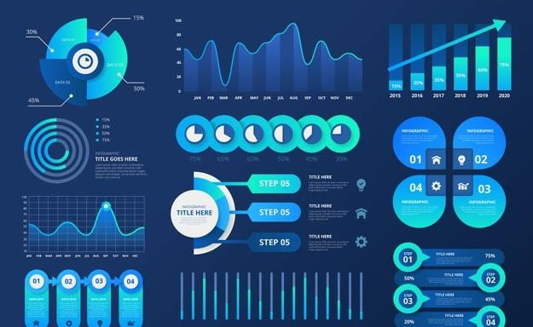
Data visualization
GRAPHICAL REPRESENTATION OF DATA

Slide 8
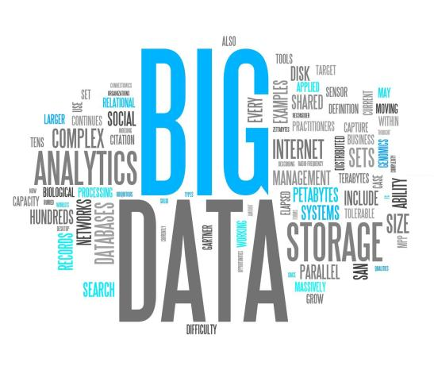
Data visualization
Data visualization tools and technologies are crucial to analyze massive amounts of information and make data-driven decisions.

Slide 9
Data visualization
Used in many areas such as:
To model complex events
Visualize phenomenon
Weather patterns,
Medical conditions,
Mathematical relationships.

Slide 10
Data visualization
Used in many areas such as:
To model complex events
Visualize phenomenon
Weather patterns,
Medical conditions,
Mathematical relationships.

Slide 11
Data visualization
Used in many areas such as:
To model complex events
Visualize phenomenon
Weather patterns,
Medical conditions,
Mathematical relationships.

Slide 12
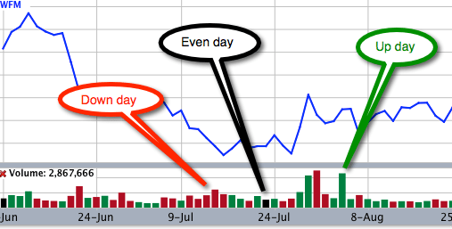
Benefits of Good Data Visualization
CAPTURE THE COLORS AND PATTERNS

Slide 13
Benefits of Good Data Visualization
Another technique of visual art.
Focus on the message captured with the help of eyes.
Identify the trends and outliers.

Slide 14
Uses of Data Visualization
Presentable and interpretable results.
Acts as a primary step in the pre-processing portion.
Supports the data cleaning process
Helps to construct and select variables
Plays a crucial role while combining the categories.

Slide 15
Different Types of Analysis for Data Visualization
Three different types of analysis for Data Visualization
Univariate Analysis
Bivariate Analysis
Multivariate Analysis

Slide 16
Different Types of Analysis for Data Visualization
Three different types of analysis for Data Visualization
Univariate Analysis
Bivariate Analysis
Multivariate Analysis

Slide 17
Different Types of Analysis for Data Visualization
Three different types of analysis for Data Visualization
Univariate Analysis
Bivariate Analysis
Multivariate Analysis

Slide 18
Univariate Analysis Techniques for Data Visualization
Distribution Plot
Distribution Plot
Box and Whisker Plot
Box and Whisker Plot
Violin Plot
Violin Plot

Slide 19
Univariate Analysis Techniques for Data Visualization
Distribution Plot

Slide 20
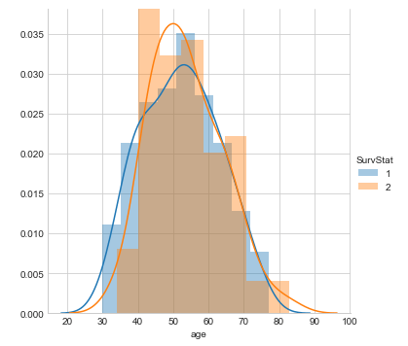
Univariate Analysis Techniques for Data Visualization
Distribution Plot

Slide 21
Univariate Analysis Techniques for Data Visualization

Slide 22
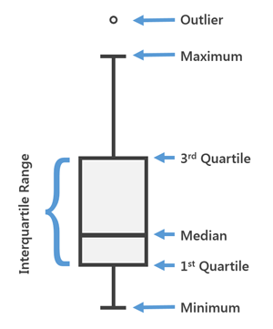
Univariate Analysis Techniques for Data Visualization
2. Box and Whisker Plot

Slide 23
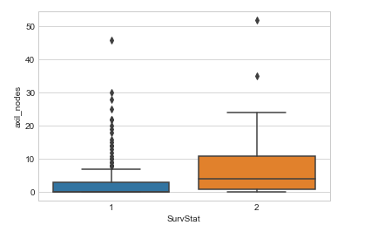
Univariate Analysis Techniques for Data Visualization
2. Box and Whisker Plot

Slide 24
Univariate Analysis Techniques for Data Visualization
2. Box and Whisker Plot

Slide 25
Univariate Analysis Techniques for Data Visualization
3. Violin Plot

Slide 26
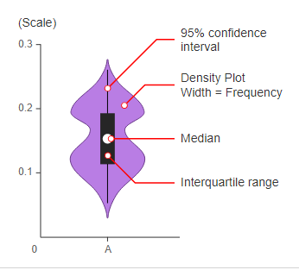
Univariate Analysis Techniques for Data Visualization
3. Violin Plot

Slide 27
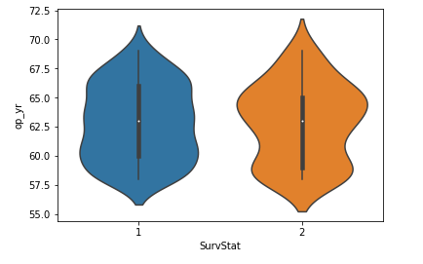
Univariate Analysis Techniques for Data Visualization
3. Violin Plot

Slide 28
Bivariate Analysis Techniques for Data Visualization
1. Line Plot

Slide 29
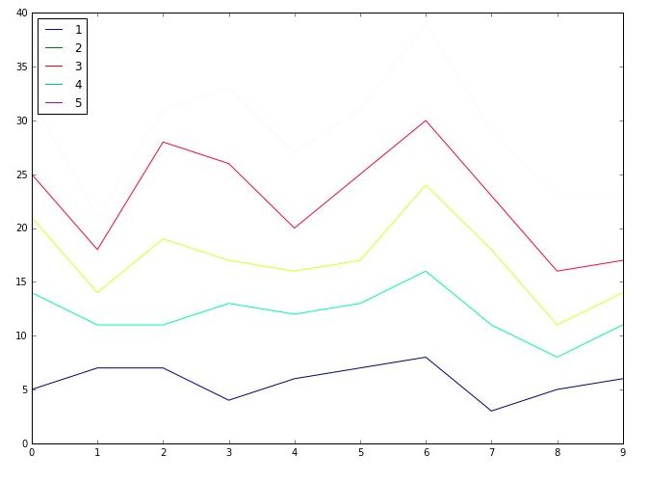
Bivariate Analysis Techniques for Data Visualization
1. Line Plot

Slide 30
Bivariate Analysis Techniques for Data Visualization
1. Line Plot

Slide 31
Bivariate Analysis Techniques for Data Visualization
2. Bar Plot

Slide 32
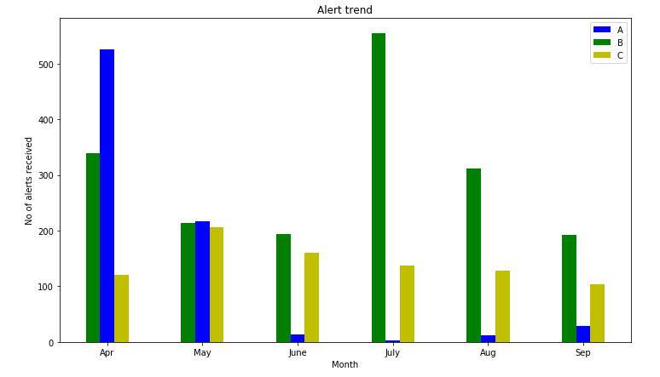
Bivariate Analysis Techniques for Data Visualization
2. Bar Plot

Slide 33
Bivariate Analysis Techniques for Data Visualization
2. Bar Plot

Slide 34
Bivariate Analysis Techniques for Data Visualization
3. Scatter Plot

Slide 35
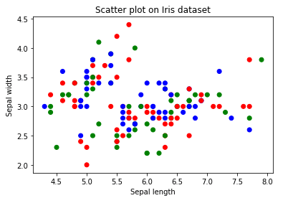
Bivariate Analysis Techniques for Data Visualization
3. Scatter Plot

Slide 36
Bivariate Analysis Techniques for Data Visualization
3. Scatter Plot

